Slide 1
Accessibility Heuristics
A practical framework for evaluating designs for accessibility

Slide 2


Caitlin Geier
User Experience Designer @CaitlinGeier
Denis Boudreau
Principal Consultant & Training Lead @dboudreau

Slide 3
Accessibility Heuristics
A practical framework for evaluating designs for accessibility

Slide 4
What are heuristics, anyway?

Slide 5

Definition of usability heuristics
UX heuristics: definition
Simple, efficient rules of thumb which designers use to make decisions about whether a user interface is usable.

Slide 6
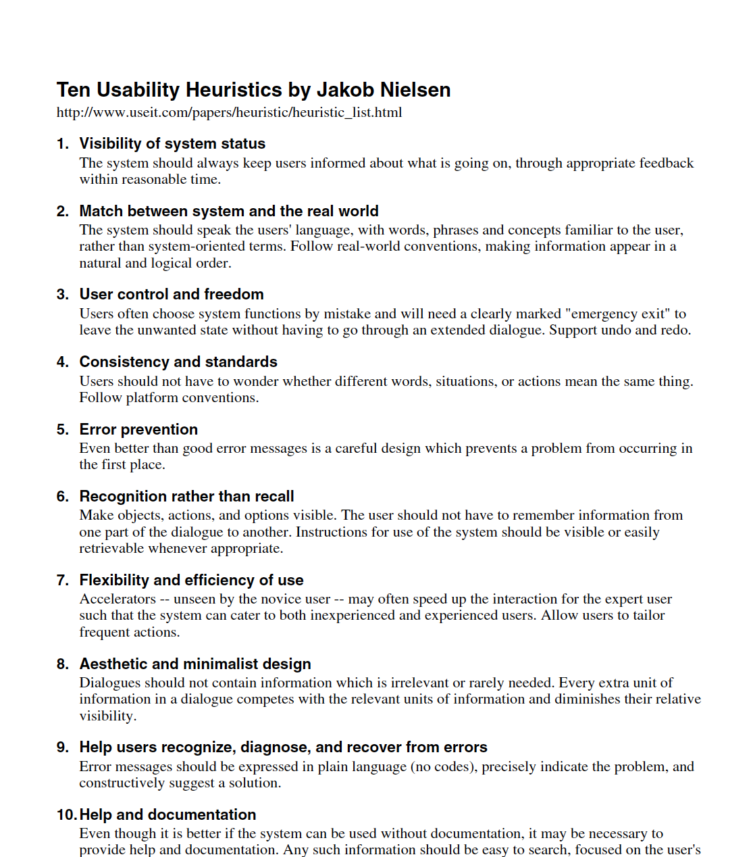

Nielsen’s 10 Heuristics
10 general principles for interaction design, set out by Jakob Nielsen in 1995.
Resource https://www.nngroup.com/articles/ten-usability-heuristics/

Slide 7

The heuristic evaluation
Scope
Choose evaluators
Define ranking scale
Evaluate
Debrief and prioritize
Report
Resource https://www.nngroup.com/articles/how-to-conduct-a-heuristic-evaluation/

Slide 8
Why heuristic evaluations work
Simple
Easy to learn
Low overhead
New viewpoint

Slide 9
Enter accessibility heuristics

Slide 10

What are a11y heuristics?.
Accessibility-specific rules of thumb. inspired from WCAG, and built for the. purpose of evaluating designs for a11y..

Slide 11

Who are accessibility heuristics for?
UX DESIGNERS
Evaluate wireframes, mockups and prototypes for accessibility
Check for issues in IA, interactions, navigation and visual design.
Doesn’t cover source code, since there usually isn’t any.

Slide 12
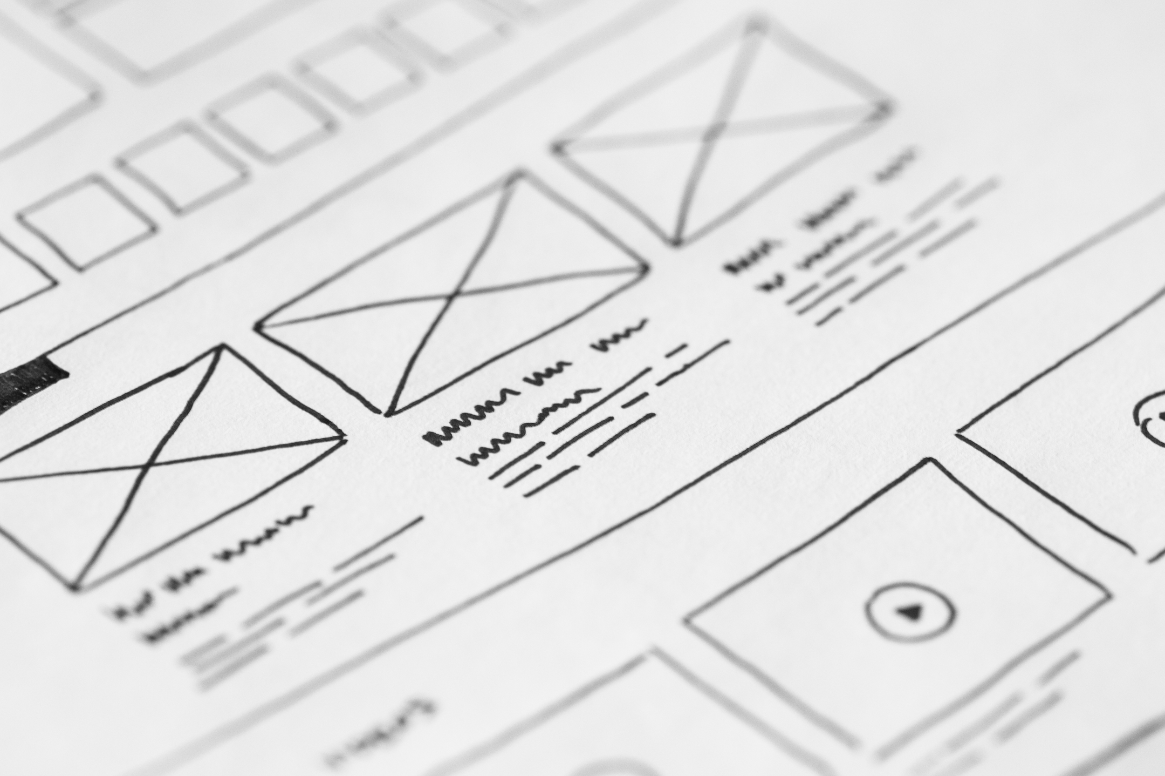
Why? Because WCAG is hard!
It’s notoriously difficult to interpret, and. a bunch of it doesn’t apply to designs or. designers anyway....

Slide 13
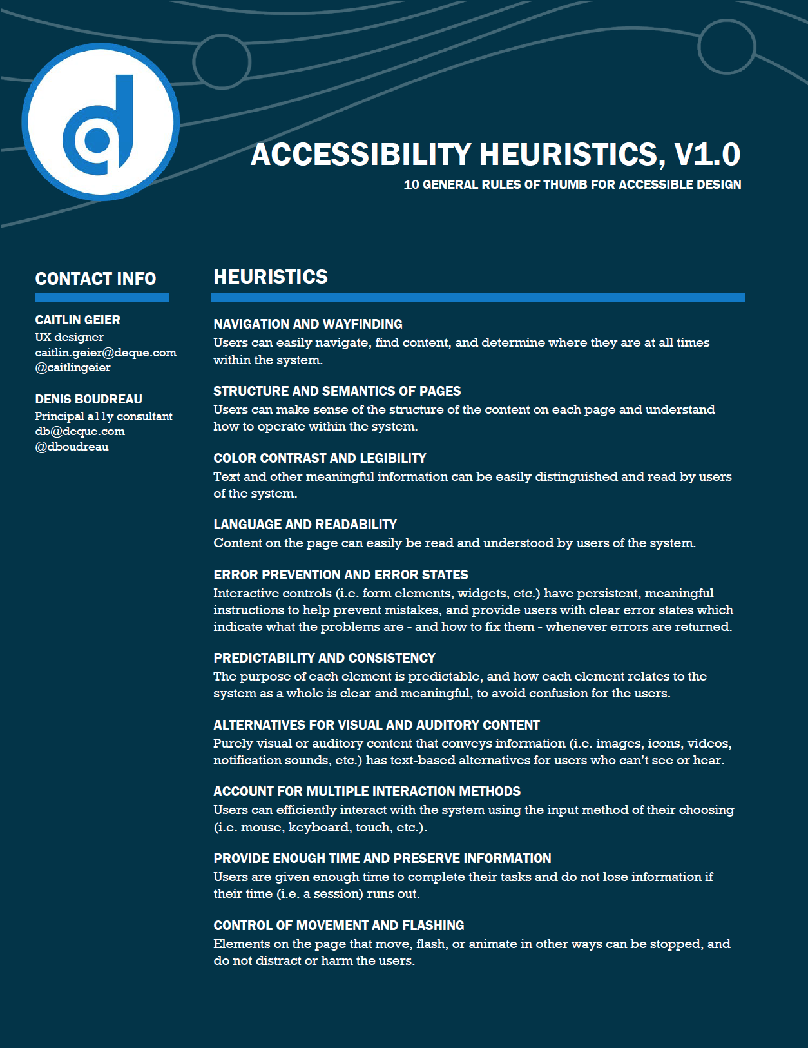
Accessibility heuristics
10 general rules of thumb to help designers understand how to integrate accessibility considerations into their work.
Resource http://bit.ly/a11y-heuristics

Slide 14
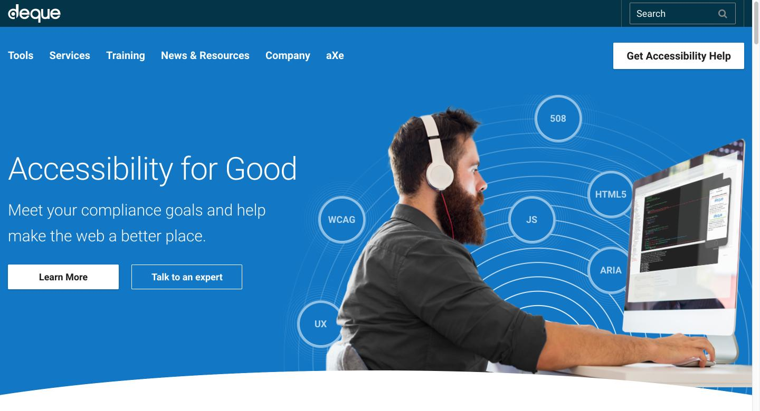

Slide 15
1. Navigation and wayfinding
“
Users can easily navigate, find content, and determine where they are at all times within the system.

Slide 16
Navigation and wayfinding What to look out for
As a starting point…
Means are provided to jump straight to the main content
Links remain meaningful even when taken out of context
Interactive elements have clear and visible focus states
Organization of navigational elements facilitate wayfinding

Slide 17
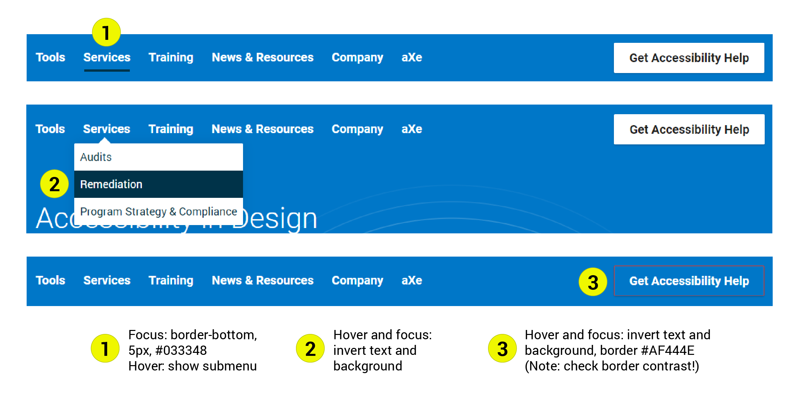
Interactive elements have clear and visible focus states

Slide 18
2. Structure and semantics of pages
“
Users can make sense of the structure of the content on each page, and understand how to operate within the system.

Slide 19
Structure and semantics of pages What to look out for
As a starting point…
Hierarchical headings are used to organize content
Navigation menus are structured using lists
Form controls are assigned meaningful text labels
Tabular data is structured using tables with header cells

Slide 20
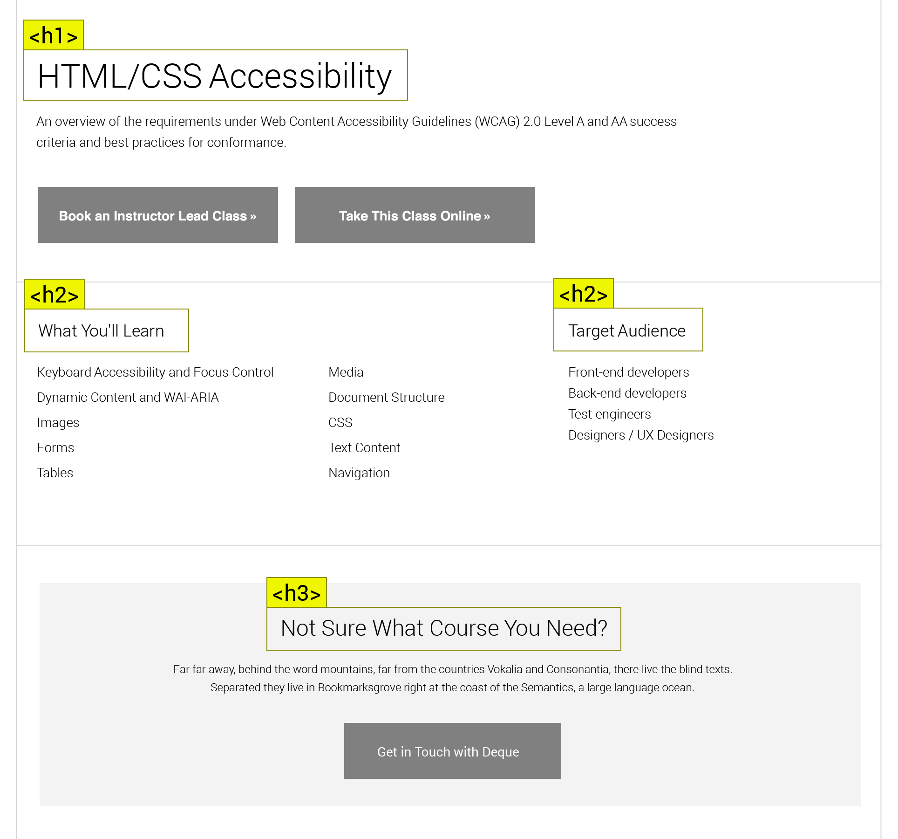
Hierarchical headings are used to organize content

Slide 21
3. Color contrast and legibility
“
Text and other meaningful information can be easily distinguished and read by users of the system.

Slide 22
Color contrast and legibility What to look out for
As a starting point…
Text has sufficient contrast against its background
Meaningful graphic elements have sufficient contrast
Link text has sufficient contrast against surrounding text
Color is not used as the only way to convey information

Slide 23
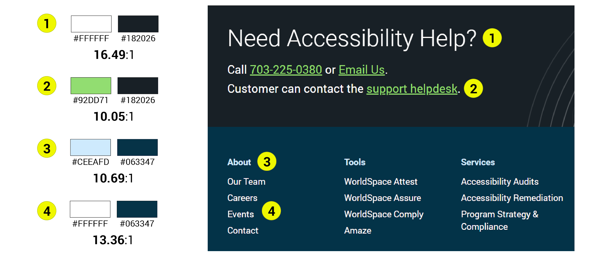
Text has sufficient contrast against its background

Slide 24
4. Language and readability
“
Content on the page can easily be read and understood by users of the system.

Slide 25
Language and readability What to look out for
As a starting point…
Plain language principles are applied to content
Labels and headings are worded to be meaningful
Text passages in different languages are identified as such
Sufficient padding and leading makes text easier to read

Slide 26
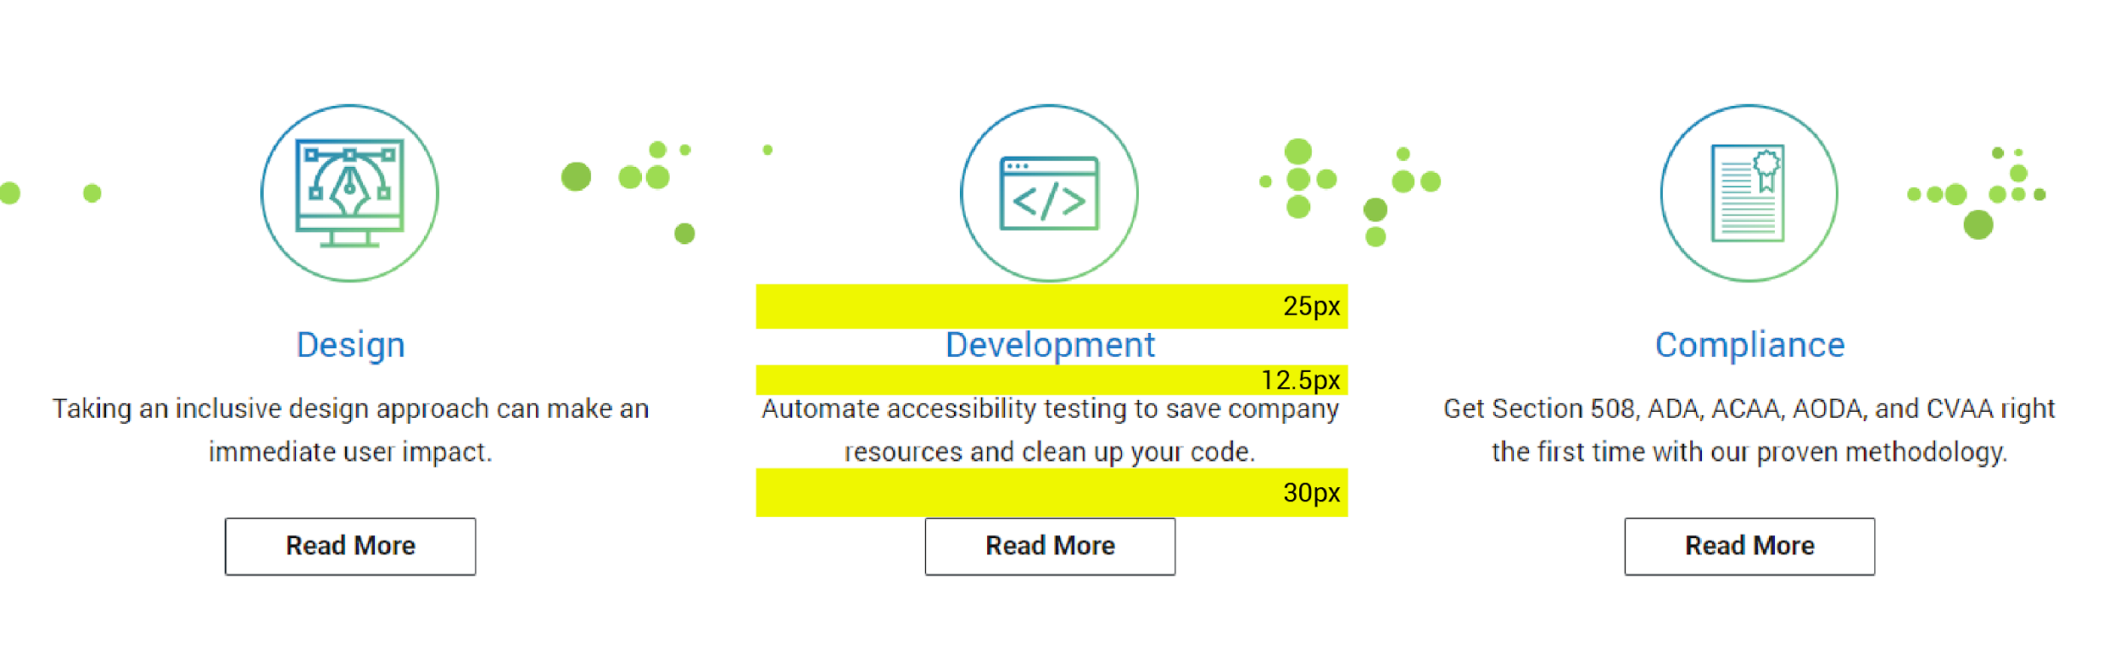
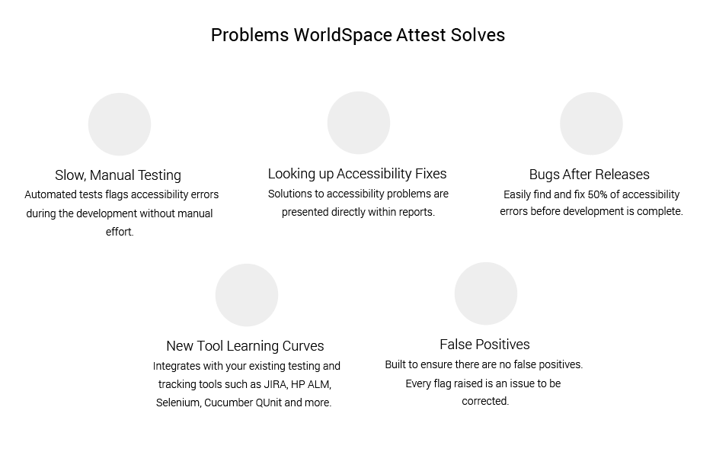
Sufficient padding and leading makes text easier to read

Slide 27
5. Error prevention and error states
“
Interactive controls (i.e. form elements, widgets, etc.) have persistent, meaningful instructions to help prevent mistakes, and provide users with clear error states which indicate what the problems are - and how to fix them - whenever errors are returned.

Slide 28
Error prevention and error states What to look out for
As a starting point…
Mandatory form controls are clearly identified as required
Instructions are provided to help prevent errors
Form inputs have persistent and meaningful labels
Inline error messages provide suggestions to fix errors

Slide 29
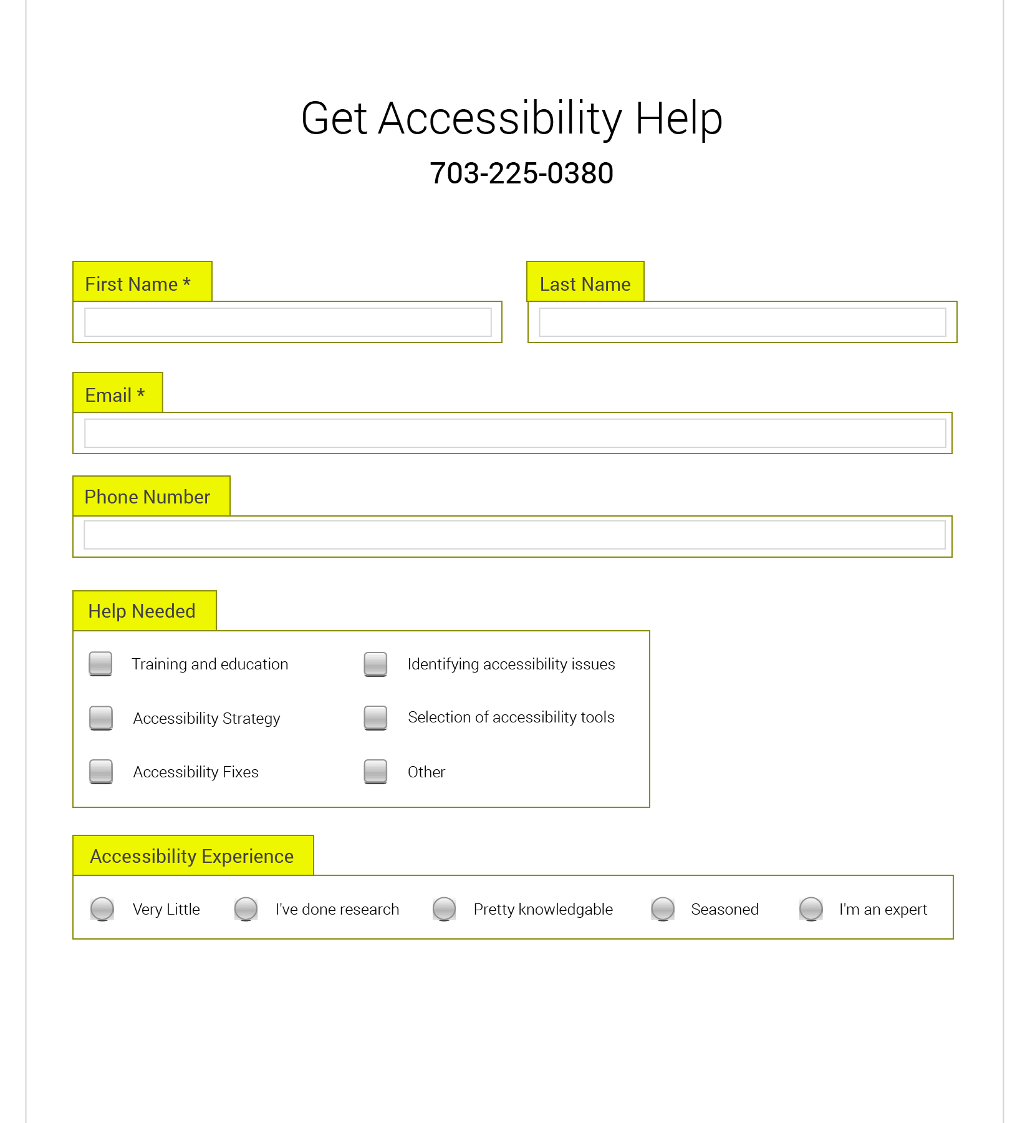
Form inputs have persistent and meaningful labels

Slide 30
6. Predictability and consistency
“
The purpose of each element is predictable, and how each element relates to the system as a whole is clear and meaningful, to avoid confusion for the users.

Slide 31
Predictability and consistency What to look out for
As a starting point…
Repeated navigation patterns are consistently presented
Recurrent functionalities are consistently identified
Changes of context are not unexpectedly triggered
Changes are clearly announced before they take place

Slide 32
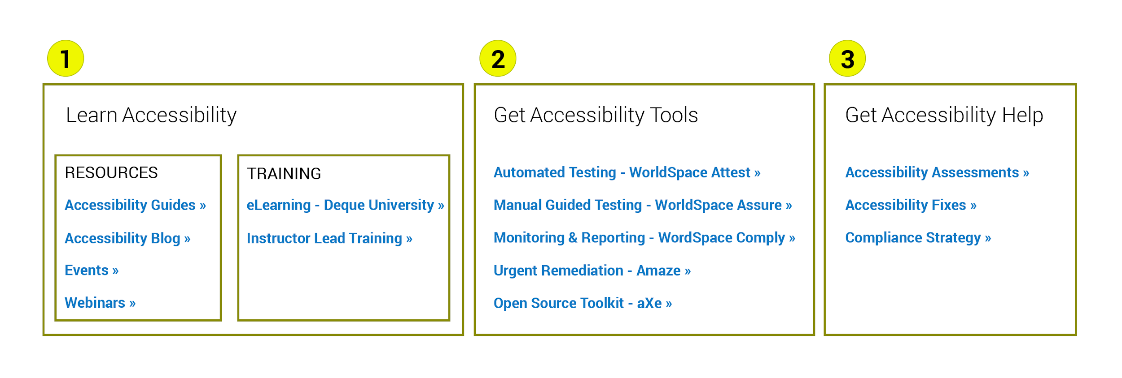
Repeated navigation patterns are consistently presented

Slide 33
7. Alternatives for visual and auditory content
“
Purely visual or auditory content that conveys information has text-based alternatives for users who can’t see or hear.

Slide 34
Alternatives for visual and auditory content
What to look out for
As a starting point…
Meaningful alt text is provided for informative images
Purely decorative images are provided with empty alt text
Synchronized captions are provided for video content
Text transcripts are provided for audio and video content
Text-based content is used instead of images of text

Slide 35
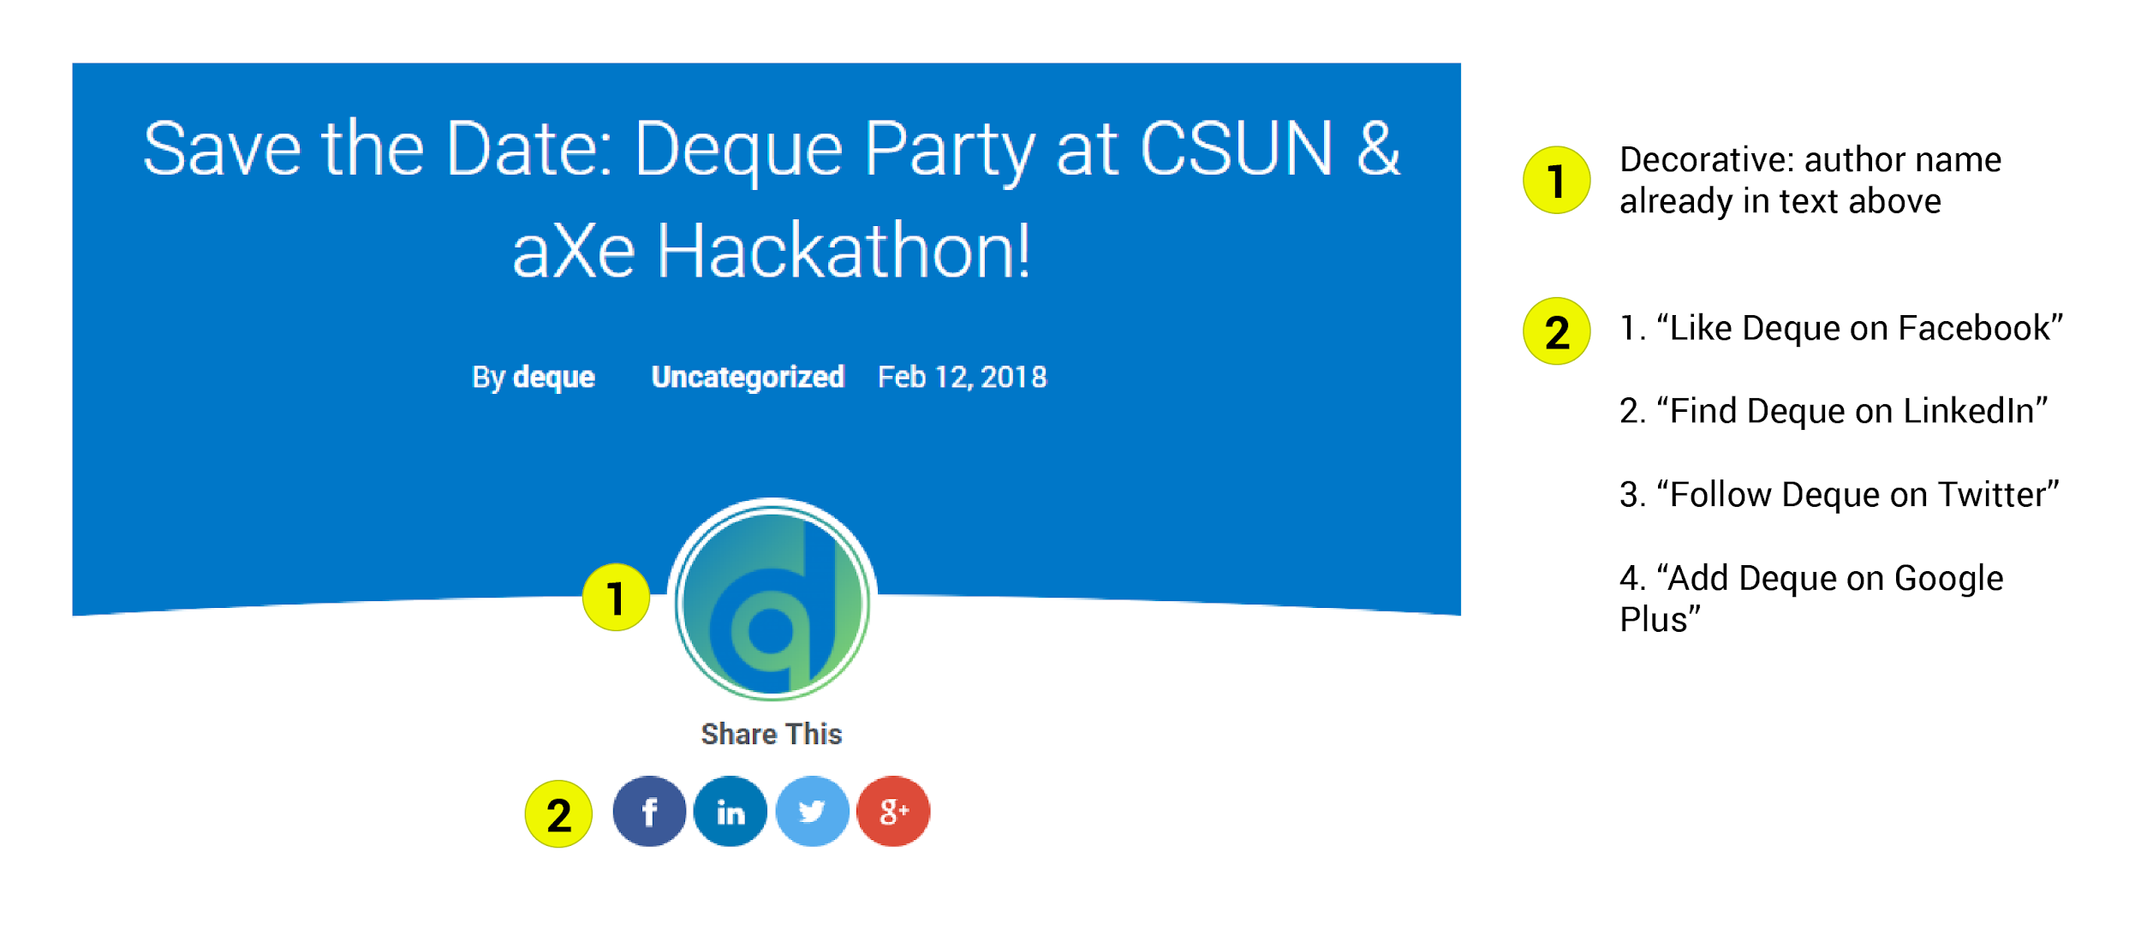
Meaningful alt text is provided for informative images

Slide 36
8. Account for multiple interaction methods
“
Users can efficiently interact with the system using the input method of their choosing (i.e. mouse, keyboard, touch, etc.).

Slide 37
Account for multiple interaction methods What to look out for
As a starting point…
Interactions are not designed to be mouse-specific
Functionalities are built to be keyboard compatible
Equivalent touch input methods are accounted for
Call to actions are labelled for voice recognition navigation

Slide 38
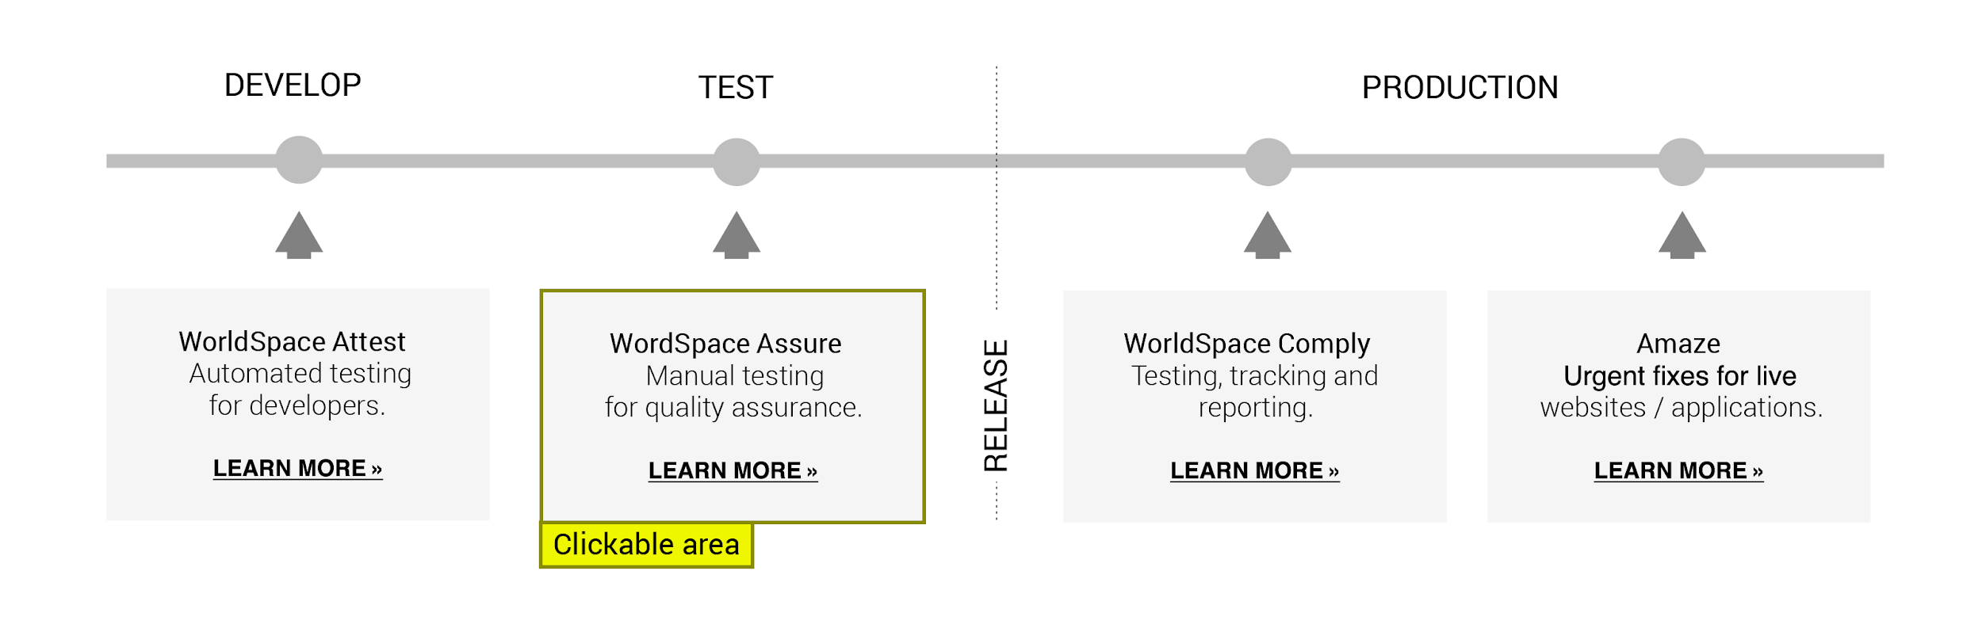
Interactions are not designed to be mouse-specific

Slide 39
9. Provide enough time and preserve information
“
Users are given enough time to complete their tasks and do not lose information if their time (i.e. a session) runs out.

Slide 40
Provide enough time and preserve information What to look out for
As a starting point…
Ways to extend or turn off time limits are provided
Upcoming session timeouts are clearly identified
Data recovery after re-authentication is accounted for
Options to postpone or suppress interruptions are offered

Slide 41
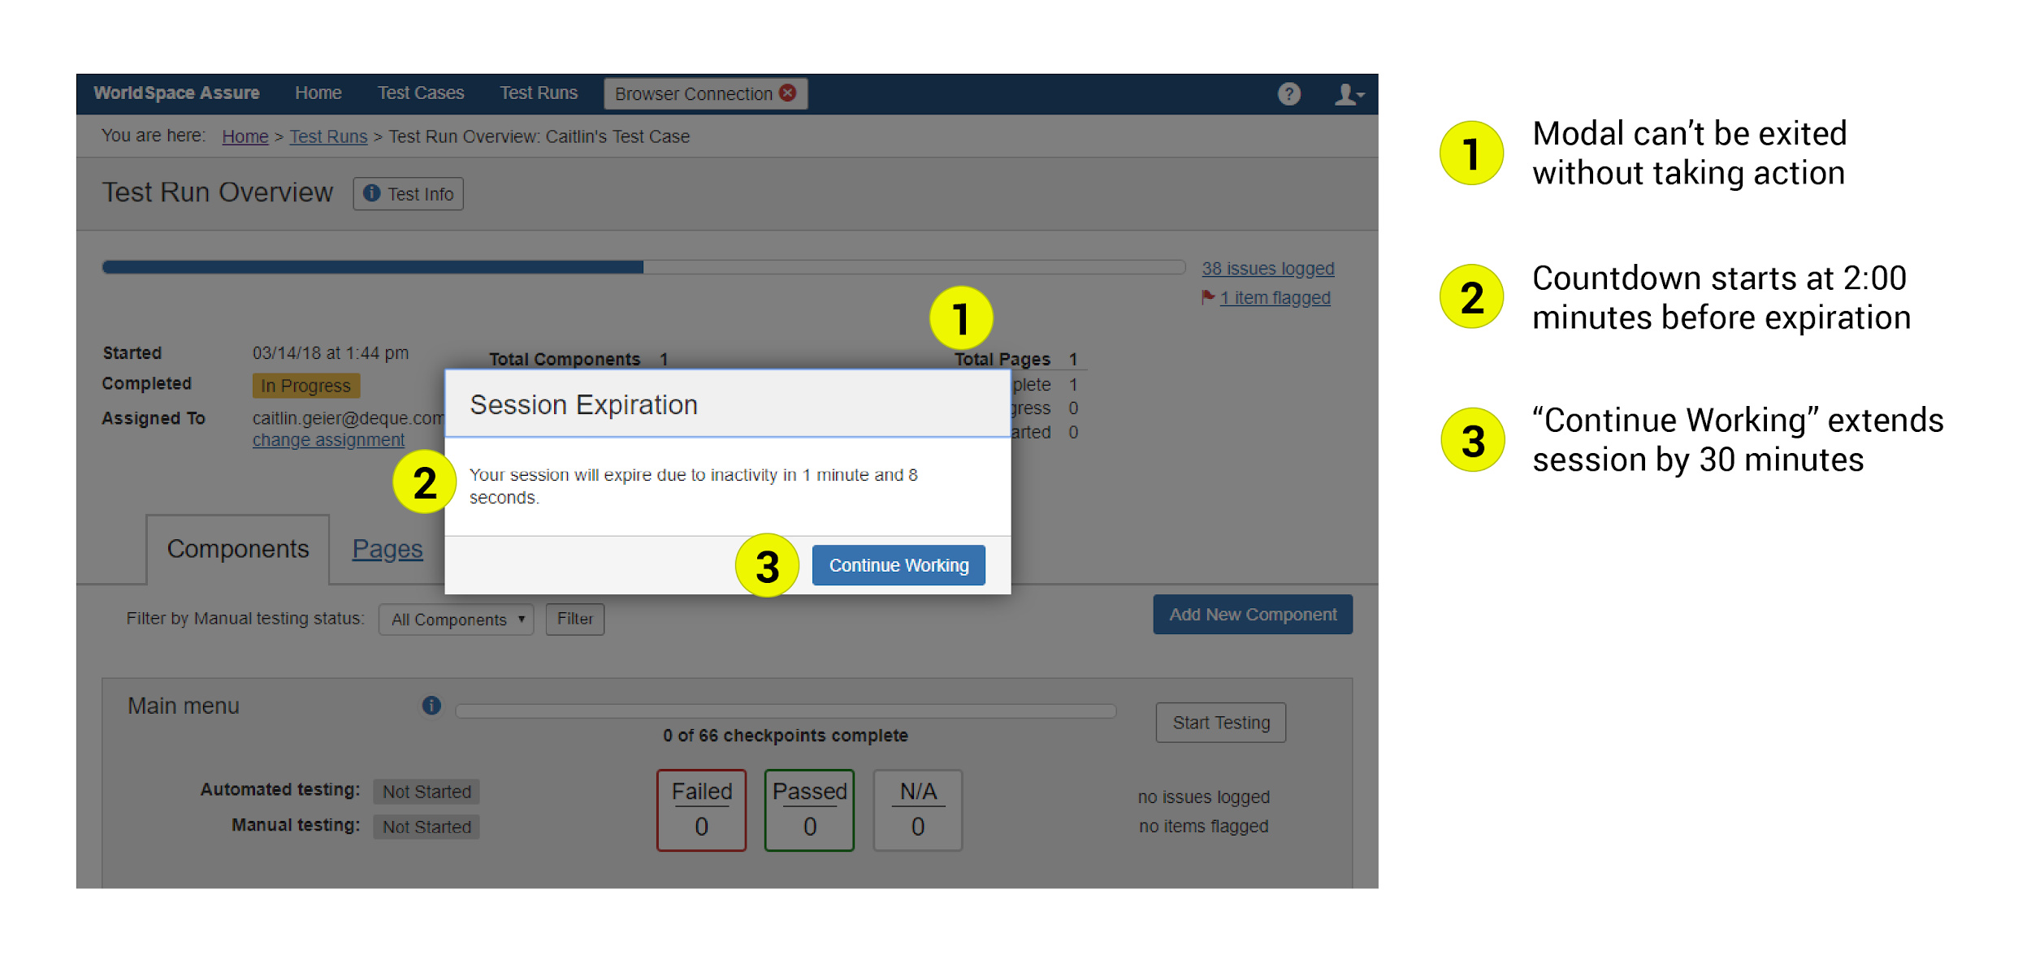
Ways to extend or turn off time limits are provided

Slide 42
10. Control of movement and flashing
“
Elements on the page that move, flash, or animate in other ways can be stopped, and do not distract or harm the users.

Slide 43
Control of movement and flashing
What to look out for
As a starting point…
Content does not flash more than three times per second
Content that moves can be stopped on demand
Video and audio files are not set on auto-play
The rate at which content is auto-updated can be controlled

Slide 44
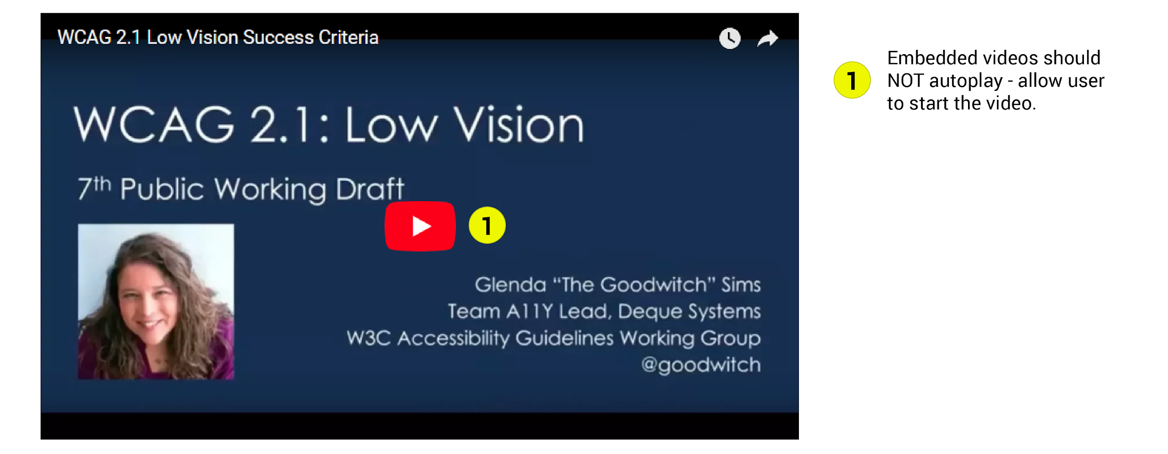
Video and audio files are not set on auto-play

Slide 45
Accessibility heuristics
The magic happens when you apply these heuristics with the the needs of various personas in mind.
Resource http://bit.ly/a11y-heuristics

Slide 46

So, what do you say?.
If you already do heuristic evaluations,. these accessibility heuristics can easily. be added to the list you’re already using..

Slide 47
Any questions?

Slide 48
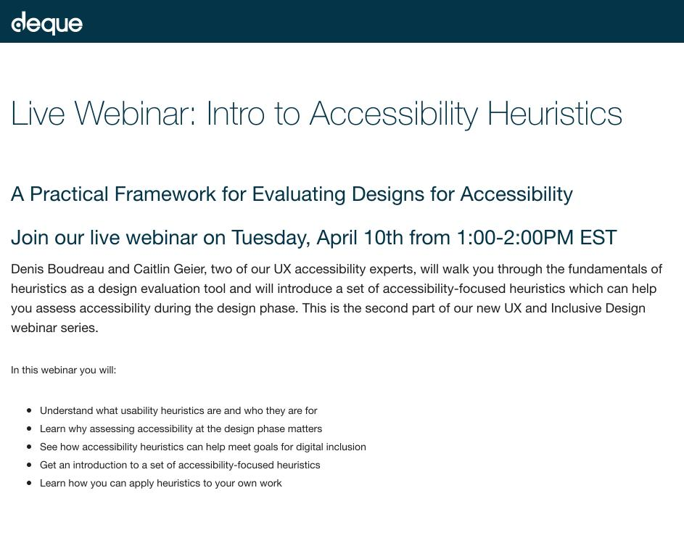
Upcoming live UX webinar (April 10th)
Join us for the next part of our live UX and inclusive design webinar series!
https://accessibility.deque.com/live-webinar-accessibility-heuristics

Slide 49

Thanks!
Sign up to receive presentation slides at:
http://www.deque.com/csun18

